Slide 1
Algorithm Analysis

Slide 2
Program Performance
A measure of the space and time a program requires
Performance analysis: analytical
Performance measurement: experimental
Often depends on the input size

Slide 3
Time Complexity
Real time constraints
May need to interact with user
May need to give results quickly
Heart Monitors
Airplane controls

Slide 4
Space Complexity
Space may be limited on the device
Embedded devices often have very limited space
Space may limit the largest problem size we can solve
Space complexity is usually less important than time

Slide 5
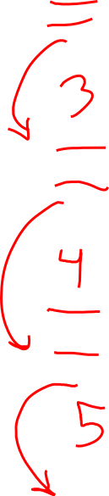
Draw Recursion
Fibonacci Numbers – 0, 1, 1, 2, 3, 5, 8, 13 …
int fib (int n){
if (n<2)
return n;
return fib (n-1) + fib (n-2);
}

Slide 6
Components of Space Complexity
Instruction space
Space needed to store the compiled version of code
Data space
Space for variables and constants
Environment stack space
Space for recursion parameters and return values

Slide 7
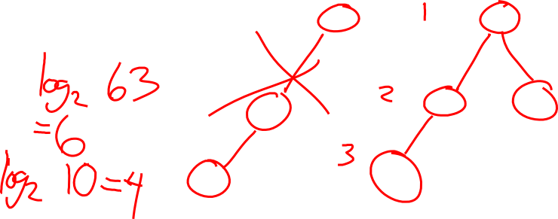
Question
For a balanced binary tree with 10 nodes, how many levels are there?
How about for 63?

Slide 8
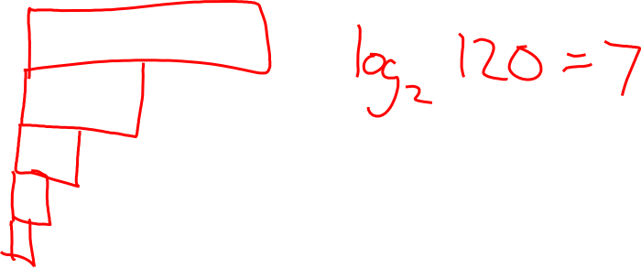
Question
If I have an array of size 120, how many times can I split the array in half?

Slide 9
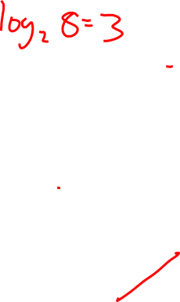
Logs

Slide 10
Components of time complexity
Amount of time spent in each operation
Difficult to measure
Estimate of number of times a key operation is performed
In small programs, actual elapsed time is difficult

Slide 11
Operation Count
Operation count: how many times you add, multiply, compare, etc.
Step counts: attempt to account for time spent in all parts of the program/function as a function of the characteristics of the program.
Key reason for operation or step counts is to compare two programs that compute the same results.

Slide 12
Operation Count
// Add matrices a and b to obtain matrix c.
void Add( int **a, int **b, int **c, int rows, int cols) {
for (int i = 0; i < rows; i++) {
count++; // preceding for loop
for(int j=0; j<cols; j++){
count++; // preceding for loop
c[i][j] = a[i][j] + b[i][j];
count++; // assignment
}
count++; // last time of j for loop
}
count++; // last time of i for loop
}

Slide 13
Per Statement Count
void Add( int **a, int **b, int **c, int rows, int cols) {
for (int i = 0; i < rows; i++){ //rows+1
for (int j = 0; j < cols; j++){ //rows*(cols+1)
c[i][j] = a[i][j] + b[i][j]; //rows*cols
}
}
}

Slide 14
Operation Counts
Key reason for operation or step counts is to compare two programs that compute the same results.

Slide 15
Asymptotics
The study of functions of n as n gets large (without bound)
If the running time of an algorithm is proportional to n, when we double n, we double the running time.
If the running time is proportional to log n ( c log n ), when we double n we only change the running time by c.
c log 2n  c(log 2  log n)  c(1  log n)  c  c log n

Slide 16
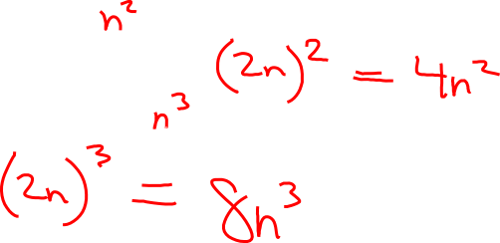
Asymptotics
What about when something is proportional to n^2 (run time is cn^2), when n doubles, what happens to the run time?
What happens with n^3?

Slide 17
Other Proportional Things
Earnings are proportional to hours worked.
Grades (may seem like) are proportional to log of work.
For some, like is proportional to
Area of square is proportional to
Volume of cube is proportional to

Slide 18
Big O
We want to give an upper bound on the amount of time it takes to solve a problem.
• Definition: v(n)  ( f (n))   constant c and n0 such that v(n)  c f (n) whenever
n  n0

Slide 19
Big O
Termed complexity but has nothing to do with difficulty of coding or understanding, just the time to execute.
Important tool for analyzing and describing the behavior of algorithms.
Most commonly used measure of complexity.

Slide 20
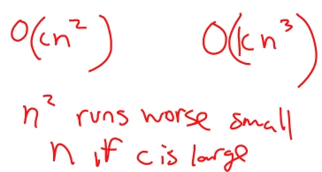
Is it perfect?
Is an (n^2 ) algorithm always better than an (n^3 ) algorithm?
Notes:
No, it depends on the specific constants.
But if n is large enough, an (n3 ) algorithm is always slower than an (n2 ) algorithm.

Slide 21
Complexity
No, it depends on the specific constants.
But if n is large enough, an (n^3 ) algorithm is always slower than an (n^2 ) algorithm.
When n is small, c may dominate
But when n is large, c becomes negligible

Slide 22
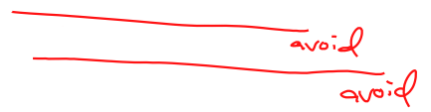
Complexity Classes
(1) constant
(logn) logarithmic
(n) linear
(nlogn) n log n
(n^2 ) quadratic
(n^3 ) cubic
(2^n ) exponential
(n!) factorial

Slide 23
Exponential
Intractable – all known algorithms to solve a problem are of exponential complexity.
What kind of problems only have exponential solutions?
Notes:
Knap sack problem

Slide 24

Notations
Name | Expression | Growth Rate | Similar to
Big-Oh | T(N)  (F(N)) | Growth of T(N) is  growth of F(N) | Less than or Equal (Upper bound)
Big-Omega | T(N)  (F(N)) | Growth of T(N) is  growth of F(N) | Greater than (lower bound)
Big-Theta | T(N)  (F(N)) | Growth of T(N) is = growth of F(N) | Equal to (tight bound)
Little-Oh | T(N) □(F(N)) | Growth of T(N) is < growth of F(N) | Less than (sub)

Slide 25
Bounds
So why not just use Big-Theta? Wouldn’t we rather have a tight bound?
Consider the difference between showing:
I can solve a problem in n^2 time. (There exists a solution I can show you.)
No solution will be any better (I can reason about ALL possible solutions.)
Clearly the first is easier, which is like Big Oh. Big Theta is like the second option, and is much more difficult.

Slide 26
Bounds
http://csilm.usu.edu/lms/nav/activity.jsp?sid=__shared&cid=emready@cs2420&lid=8&aid=506963444

Slide 27
Measuring Complexity
Because constants in the equation will eventually be overwhelmed by n, we leave them out.
The constants only shift the graph
When we consider complexity, we want to know the line/curve behaves rather than exact numbers
The complexity classes describe the behavior, so we simplify to them

Slide 28
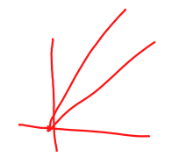
Measuring Complexity
We remove constants because they only shift the graph. But it is still a line, log, exponential, etc graph.
Example: In the sketch, both functions are lines, so we say they are O(n). We do not care about constants, because a function of n multiplied or summed with a constant is still a line, which will increase at a steady rate.

Slide 29
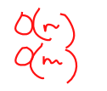
Measuring Complexity
Additive Property – If two statements follow one another, the complexity of the two of them is the larger complexity.
Consider:
for (i=0; i < n; i++) x++
for (j=0; j < m; j++) x++
There are two values that affect the complexity: m and n.
The first statement has complexity (n) . The second statement has complexity (m) . The complexity is (n + m)
The additive property indicates: (n + m)  (max(n, m)) .

Slide 30
Measuring Complexity
If/Else: The complexity is the running time of the condition(s) plus the running time of the most complex option.
Consider:
if ( cond ) S1 else S2
The complexity is the running time of the cond plus the larger of the complexities of S1 and S2.

Slide 31
Measuring Complexity
Multiplicative Property:
For Loops: the complexity of a for loop is at most the complexity of the statements inside the for loop times the number of iterations.
However, if each iteration is different in length, it is more accurate to sum the individual lengths rather than just multiply.

Slide 32
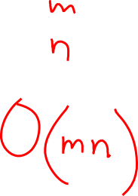
Nested For Loops
for (int i = 0; i < m; i++)
for (int j = 0; j < n; j++)
x++;
Notes:
Draw n*m block
(mn)
Let each row represent the work done in one iteration of the outermost loop. The number of rows represents the number of times the outermost loop executes. The area of the figure will then represent the total work.

Slide 33
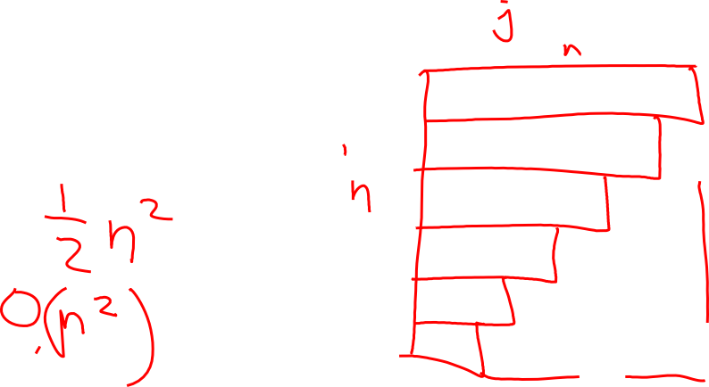
Nested For Loops
for (int i = 0; i < n; i++)
for (int j = i; j < n; j++)
x++;
Notes:
Draw stair case
Complexity is n^2
In this example, our complexity picture is
triangular. The outermost loops executes n times, but since
each time the j loop is called it is has a different
beginning location, the rows are of different length.
The complexity is O(n2)

Slide 34
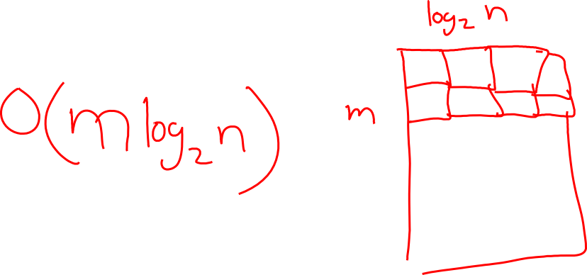
Nested For Loops
for ( int i = 0; i < m; i++ )
for ( int j = n; j >0 ; j/=2)
x++ ;
Notes:
In this example, the complexity picture looks like
an upside down staircase. The outermost loop executes m times, but the
number of times the j loop executes is logarithmic.
The complexity is (m log n) .

Slide 35
Example
Maximum Subsequence Sum
We have an array of integers. We want to know the largest sum of adjacent locations

Slide 36
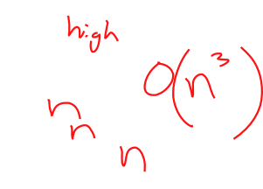
Example
int addRange (int a[], int low, int high) {
int sum=0;
for (int i=0; i <high, i++)
sum+=a[i];
}
for (int i=0; i < n; i++) {
for (int j=i; j < n; j++) {
sum = addRange(a,i,j);
if (sum > maxSum) {
maxSum = sum;
low = i;
high = j;
}
}
}
Notes:
N^3 complexity
Notice to improve complexity we can’t just do something half as often (as half is a constant). We must reduce it by a factor of n.
Improvement: keep a running sum, don’t recalculate in the function every time

Slide 37
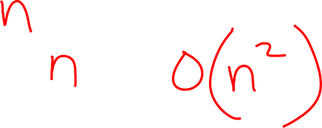
Example
for (int i=0; i < n; i++) {
sum=0;
for (int j=i; j < n; j++) {
sum+=a[j];
if (sum > maxSum) {
maxSum = sum;
low = i;
high = j;
}
}
}
Notes:
With a running sum
Complexity n^2
Notice to improve complexity we can’t just do something half as often (as half is a constant). We must reduce it by a factor of n.
Improvement- A negative sum will not begin a subsequence (as you would be better off removing it).

Slide 38
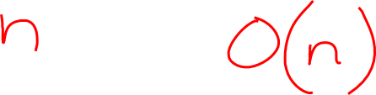
Example
int sum=0, bestSum = 0, i = 0;
for (int j=0; j < n; j++) {
sum += a[j];
if (sum >bestSum) {
bestSum=sum;
low=i;
high= j;
}
else if (sum < 0) {
i=j+1;
sum=0;
}
}
Notes:
Complexity – linear
Not every algorithm can be taken down to a linear complexity, but we should always try

Slide 39
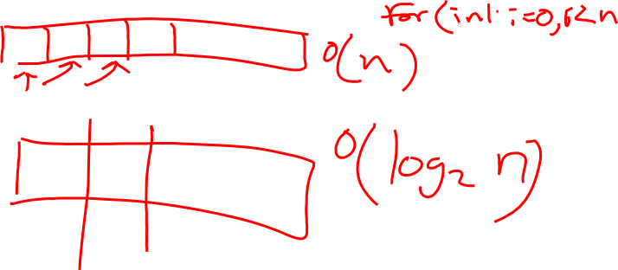
Searching
What is complexity of a sequential search?
What is the complexity of a binary search?

Slide 40
Searching
Interpolation search is like a binary search except you pick a more intelligent choice for the next search point. Based on the value you are looking for, you estimate which fraction of the remaining array you should skip, convert that to a number, and add to the low bound.
What is the complexity?
Notes:
The complexity is difficult to estimate, but likely it isn’t much better than binary.
If distribution isn’t consistent, we could actually take more time as our estimates are bad.
With approximately even distribution of values, estimates say the search is
(log log n) .
Point is – changing complexity classes is difficult. Just being a little smarter likely doesn’t change complexity classes.

Slide 41
Recursion
void doit(int n) {
if (n==1) return;
for (int i=0; i < n; i++)
x = x + 1;
doit(n-1);
}
Complexity is the time for the current call + successive calls
T(n) = n + T(n-2)
Called a recurrence relation because T(n) is defined in terms of T

Slide 42
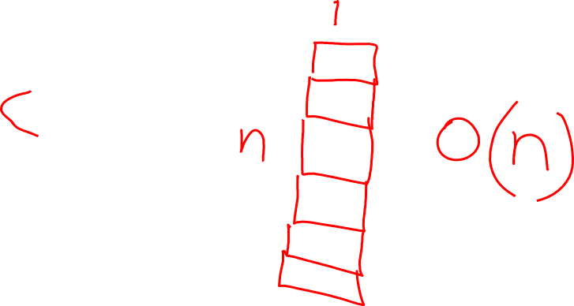
Recursion
void doit(int n) {
if (n==1) return;
x = x + 1;
doit(n-1);
}
Notes:
n

Slide 43
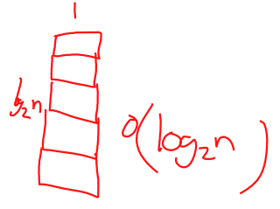
Recursion
void doit(int n) {
if (n==1) return;
x = x + 1;
doit(n/2);
}
Notes:
Log(n)

Slide 44
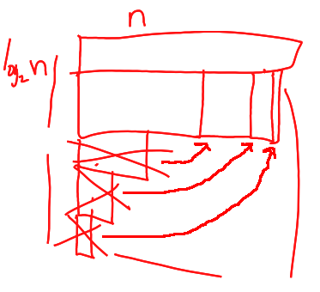
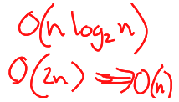
Recursion
void doit(int n) {
if (n==1) return;
for (int i=0; i < n; i++)
x = x + 1;
doit(n/2);
}
Notes:
2n

Slide 45
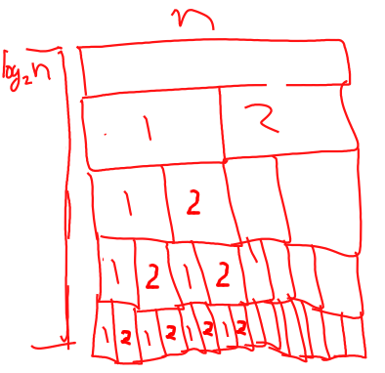


Recursion
void doit(int n) {
if (n==1) return;
for (int i=0; i < n; i++)
x = x + 1;
doit(n/2);
doit(n/2);
}
Notes:
N log(n)

Slide 46
A formula Approach
Theorem: AssumeT(n)aT(n/b)(n^k ) is the time for the function.
If ab^k ,the complexity is (n^(logb a)).
If ab^k ,the complexity is ((n^k) logn).
If ab^k, the complexity is (n^k).
A is the number of recursive calls we make within the function
B is the number of pieces we divide the problem into
K is the power of n work we do inside of each call

Slide 47
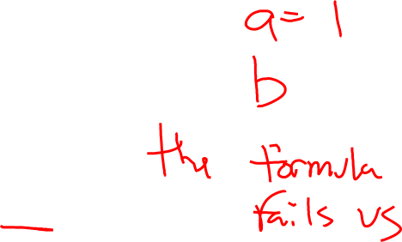
Recursion
void doit(int n) {
if (n==1) return;
x = x + 1;
doit(n-1);
}
Notes:
n

Slide 48
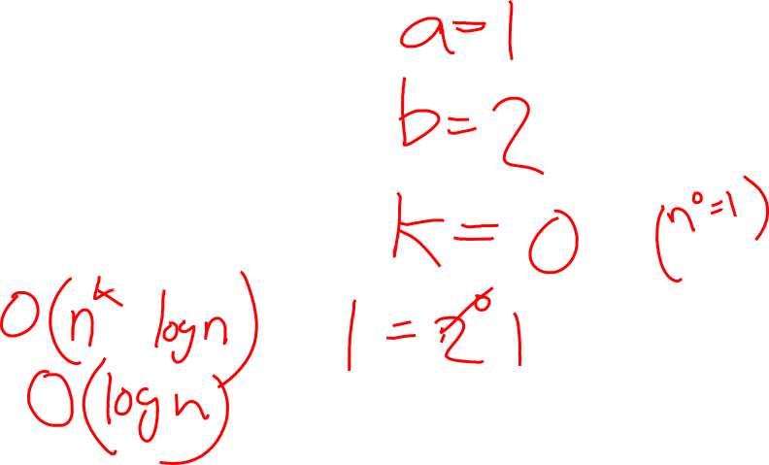
Recursion
void doit(int n) {
if (n==1) return;
x = x + 1;
doit(n/2);
}
Notes:
Log(n)

Slide 49
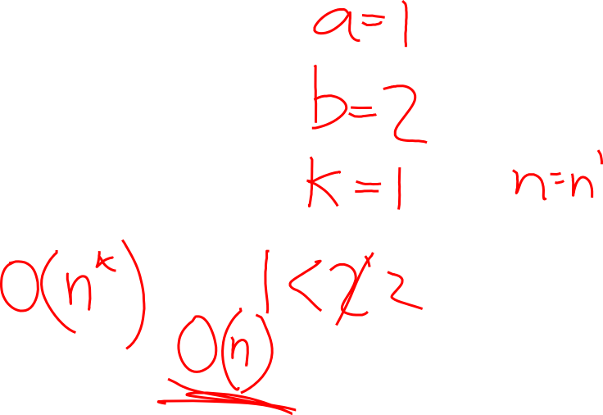
Recursion
void doit(int n) {
if (n==1) return;
for (int i=0; i < n; i++)
x = x + 1;
doit(n/2);
}
Notes:
2n

Slide 50
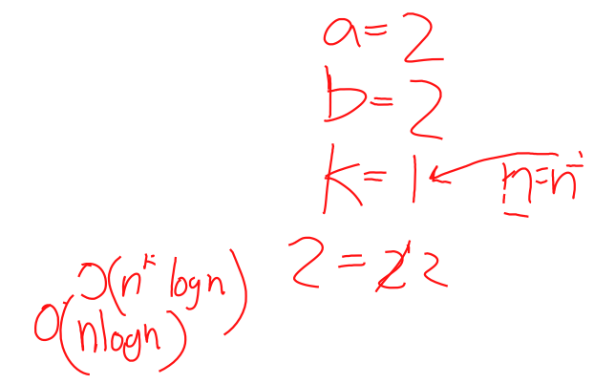
Recursion
void doit(int n) {
if (n==1) return;
for (int i=0; i < n; i++)
x = x + 1;
doit(n/2);
doit(n/2);
}
Notes:
N log(n)

Slide 51
Determine Complexity from Experiments
Can use operation counts, or timing results
Timing results are easier, but less acurate
We usually use timing

Slide 52
Timing
To use timing, you need data from many different problem sizes
Consider n=32, and T(n)=800
The complexity could be anything:
(1) with c800
(n) with c25
(logn) with c160
(n^2) with c.78

Slide 53
Timing
Two data points are also insufficient
We will usually work with 4 – 6 data points, with n doubling each time

Slide 54
Guessing
(1) is basically constant.
(log n) grows slowly, by a constant between entries.
(n) doubles between entries.
(n log n) slightly more than doubles between entries .
(n2 ) quadruples between entries.
(2^n ) grows exponentially .

Slide 55
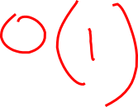
Complexity from Timing
n | T(n)
2 | 10
4 | 10
8 | 10
16 | 11
32 | 8
Notes:
Constant
C=10

Slide 56
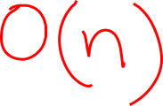
Complexity from Timing
n | T(n)
2 | 10
4 | 17
8 | 32
16 | 66
32 | 130
Notes:
N – linear
C=4

Slide 57
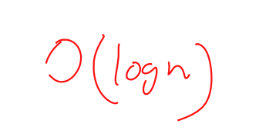
Complexity from Timing
n | T(n)
2 | 10
4 | 10
8 | 15
16 | 20
32 | 25
Notes:
Log (n)
C=5

Slide 58
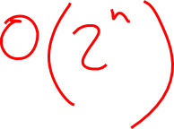
Complexity from Timing
n | T(n)
2 | 8
4 | 32
8 | 500
16 | 65,600
32 | 4,294,976,300
Notes:
Exponential 2^n
C= 2

Slide 59
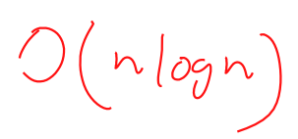
Complexity from Timing
n | T(n)
2 | 2
4 | 8
8 | 25
16 | 64
32 | 161
Notes:
N log n
C=1

Slide 60
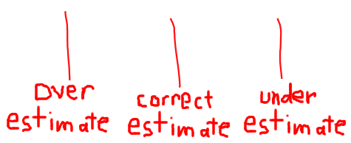
Timing- Another Way
n | Actual Time | N^3 | Ratio | N^2 | Ratio | N log n | Ratio
4 | 75 | 64 | 1.17 | 16 | 4.7 | 8 | 9.4
8 | 219 | 512 | .43 | 64 | 3.4 | 24 | 9.1
16 | 1104 | 4096 | .27 | 256 | 4.3 | 64 | 17.2
32 | 4398 | 32768 | .13 | 1024 | 4.3 | 160 | 27.5
64 | 17632 | 262144 | .07 | 4096 | 4.3 | 384 | 45.9
Notes:
If the ratio decreases, it is an overestimate
If the ratio increases, it is an underestimate
If the ratio is relatively constant, then it is the complexity

